Slide 1

ASP.NET MVC
Hariharasudhan. C
Karthikkannan. M

Slide 2
Agenda
What is MVC Architecture?
ASP.Net Web Forms vs MVC
MVC Features
Lifecycle of an ASP.NET MVC 5 Application
Bundling and Minification
Routing
Views
Filters
State Management
Entity Framework

Slide 3
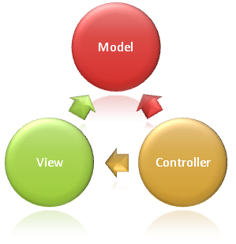
What is MVC Architecture?

Slide 4
ASP.Net Web Forms vs MVC
Web Forms | MVC
Traditional event-driven development model | Pattern based development model
File based URLs | Route based URLs
User Controls for code re-usability | Partial views for code re-usability
Tightly coupled (.aspx &.aspx.cs) | Loosely coupled (separation of concerns)
UI uses Server controls | HTML helpers generate UI controls

Slide 5
MVC Features
Separation of Concerns
URL Mapping and Routing
Dependency Injection
Scaffolding
Filters
Identity Management

Slide 6
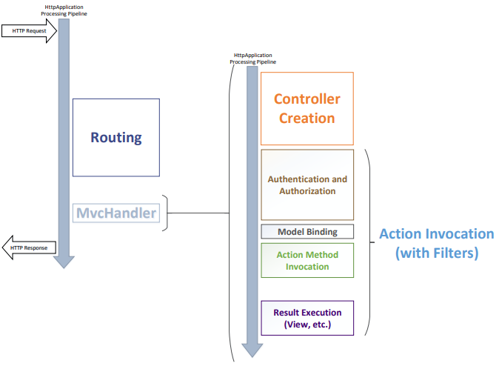
Lifecycle of an ASP.NET MVC 5 Application

Slide 7
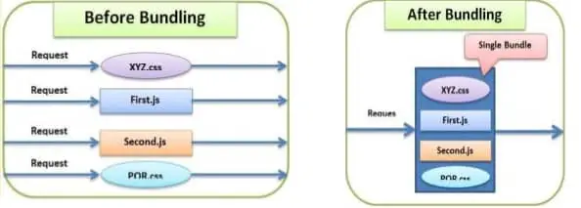
Bundling And Minification

Slide 8
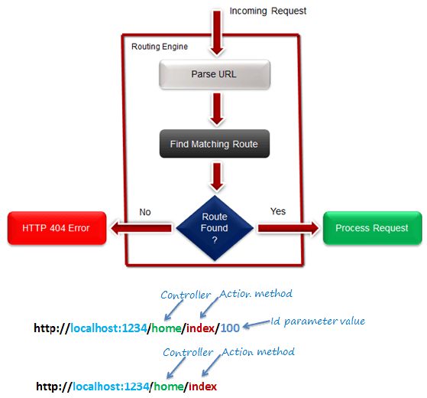
Routing

Slide 9
Views
Responsible for User Interface
aspx/ascx/cshtml/vbhtml
Razor View Engine
Layouts
HTML helpers

Slide 10
Filters
Authorization
Action
Result
Exception

Slide 11
State Mangement
Hidden Field
Cookies
Query String
ViewData
ViewBag
TempData

Slide 12
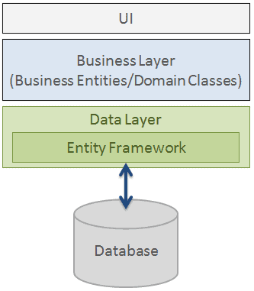
Entity Framework

Slide 13
Entity Framework Features
Entity
DB Context
Query
Change Tracking
Save Changes
Concurrency
Configurations
Migrations

Slide 14

Questions?

